Slide 1

JAWAHARLAL DARDA INSTITUTE OF ENGINEERING AND TECHNOLOGY,YAVATMAL
PROJECT INTERNAL SUBMISSION
PRESENTATION ON
“ARDUINO BASED UNDERGROUND CABLE FAULT LOCATOR”
Presented By
Ms. Arpita Waikar Ms. Prachi Kapuskar
Ms. Payal Aware Mr. Himanshu Chawardol
Mr. Swapnil Thakre Mr. Sajan Mude
Under Guidance Of
Dr. P.M. Pandit
(Project Guide)
DEARTMENT OF ELECTRICAL ENGINEERING
Session 2020-2021

Slide 2

CONTENTS
INTRODUCTION
LITERATURE SURVEY
BLOCK DIAGRAM
BASIC COMPONENTS
CIRCUIT DIAGRAM
WORKING
RESULT
ADVANTAGES
APPLICATIONS
CONCLUSION
REFERENCES

Slide 3

INTRODUCTION
Problem Formulation
Difficult to find out exact location
Difficult to dig out cable
Time consuming existing methods
Objective Of Project
Determine The Fault Location.
Save Time Required for Locating Faults.
Save Efforts and Labour cost.

Slide 4
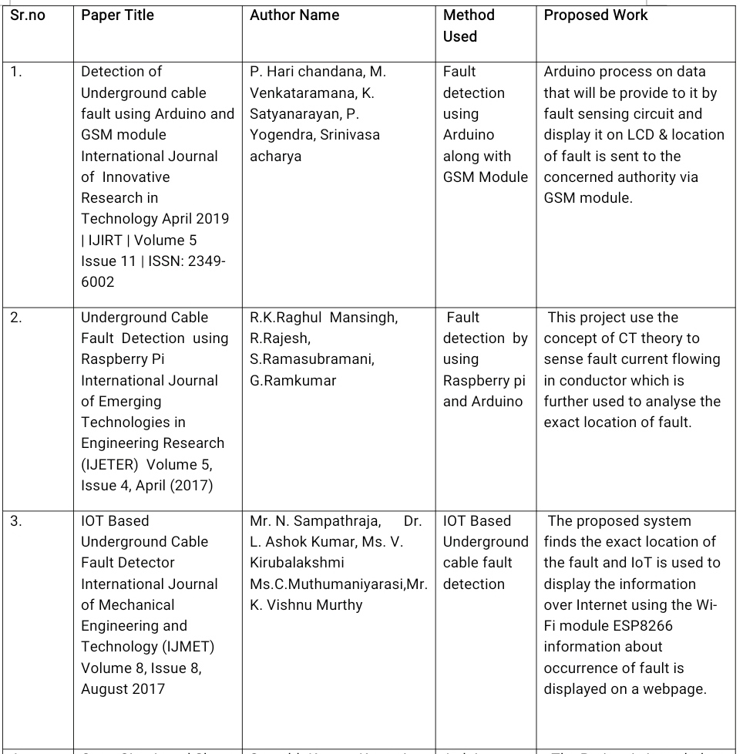
LITERATURE SURVEY

Slide 5
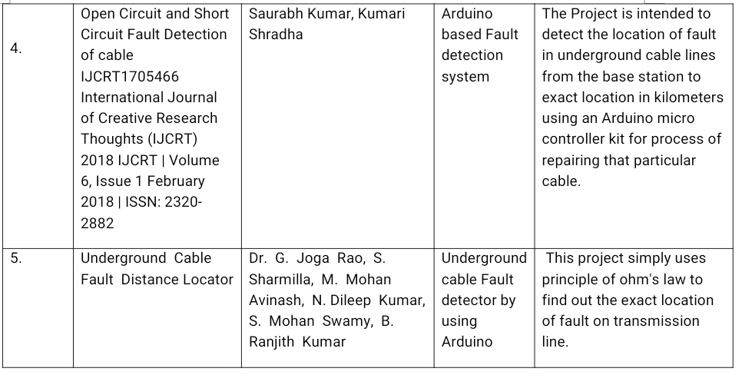

Slide 6
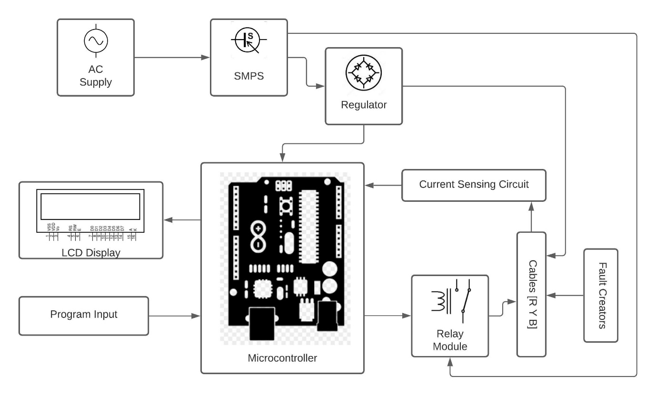
BLOCK DIAGRAM OF PROPOSED SYSTEM

Slide 7
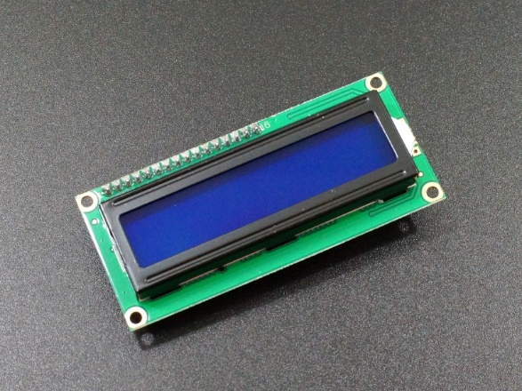
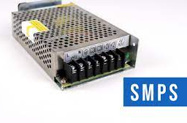
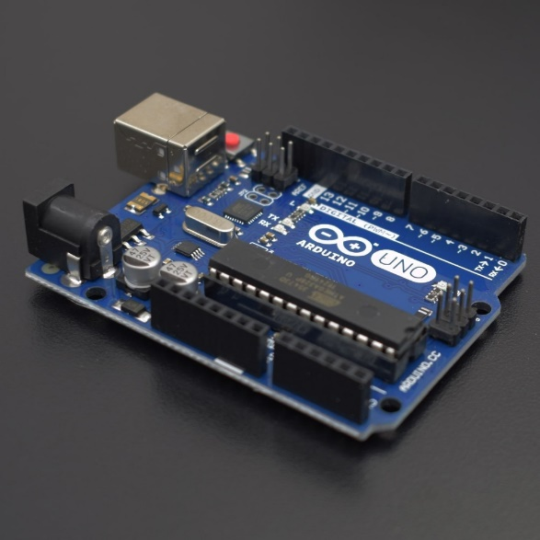
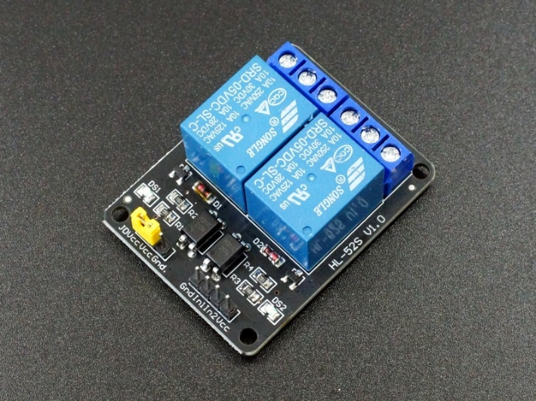
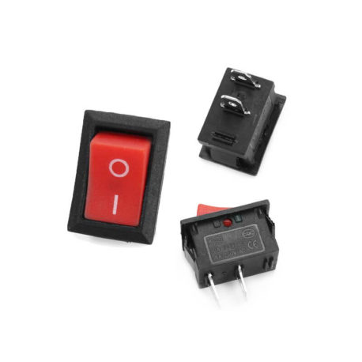
Main Components Used :
Arduino
Relay Modules
SMPS
LCD display
Switches

Slide 8
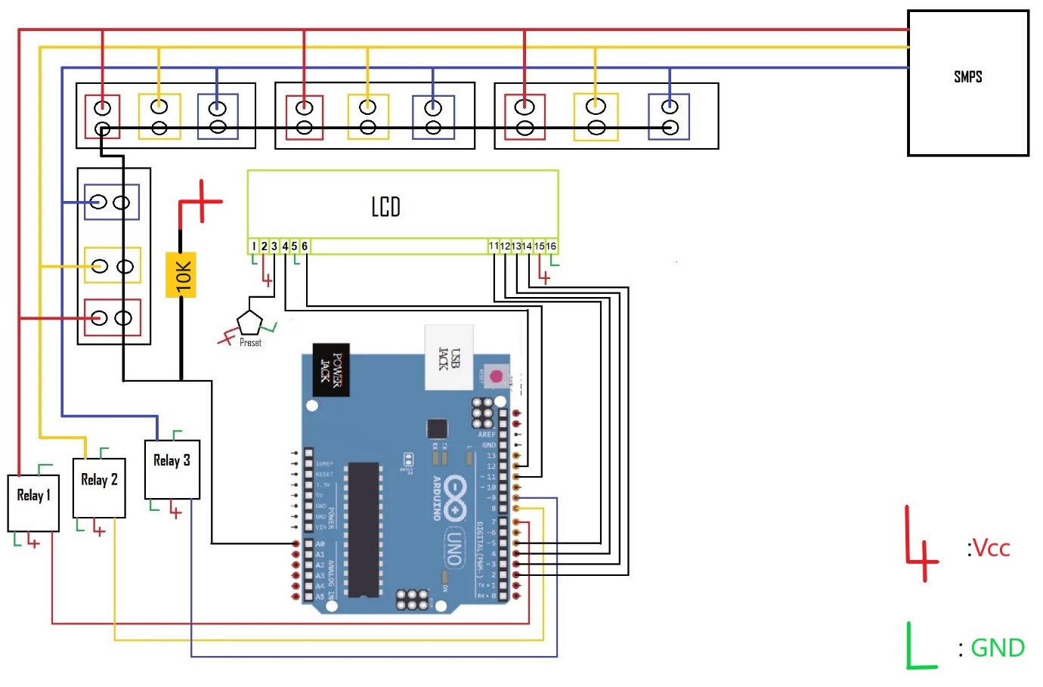
Circuit Diagram

Slide 9
WORKING
Working principle :Ohm’s law (i. e V=IR or R=V/I)
Main role : sensor wire (connected to arduino at one end & fault points at another end)
Sensor wire: it is a simple cable divided into fixed no. of parts, each part having equal value of resistance.
Fault current passes through desired different parts of sensor cable depending upon the distance of fault.
Flow of fault currents at different distances introduces different values of voltage drops across the sensor cable.
Applying ohm’s law, exact resistance value is obtained from the voltage drops.
Calculated resistance values are entered directly into the program.
Depending upon different resistance values, different fault distances are displayed.

Slide 10
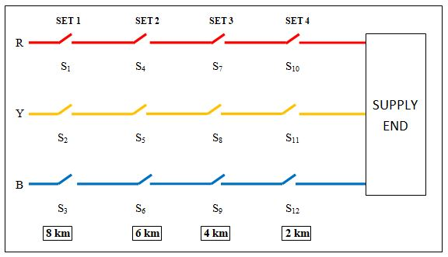
RESULT Result of the project is classified on the basis of 2 main conditions:
Single fault on single line
Multiple faults on single line

Slide 11
Single fault on single line:
Sr. no | ON switches | Status at R | Status at Y | Status at B
1. | S₁ S₂ S₃ | 8 km | 8 km | 8 km
2. | S₄ S₅ S₆ | 6 km | 6 km | 6 km
3. | S₇ S₈ S₉ | 4 km | 4 km | 4 km
4. | S₁₀ S₁₁ S₁₂ | 2 km | 2 km | 2 km

Slide 12
2) Multiple faults on single line
Step no. | ON switches | Status at R | Status at Y | Status at B
1. | S₁ S₄ S₇ S₆ | 8 km | N.F | 6 km
2. | S₄ S₇ | 6 km | N.F | N.F
3. | S₇ | 4 km | N.F | N.F

Slide 13

ADVANTAGES:
Advantages
Accuracy
Efficient
&
Reliability
Wide Range of Distances
Human Friendly
Handy
Low Maintenance
Improved Public Safety
Cost Effective

Slide 14
APPLICATIONS
Monitoring faults in Industrial Lines.
Fault detection in communication cables.
Fault detection in underground power cables.
Monitoring faults in Residential Lines.
Monitoring faults in Overhead Lines.

Slide 15
CONCLUSION
This system provides the data of fault location at the designed distances , this data is quite exact and particular to the fault occurrence. Implementation of proposed method will prove more advantageous over the conventional methods , As all these conventional methods requires the whole cable to be dig out in order to locate the fault point and carry out the maintenance work.

Slide 16
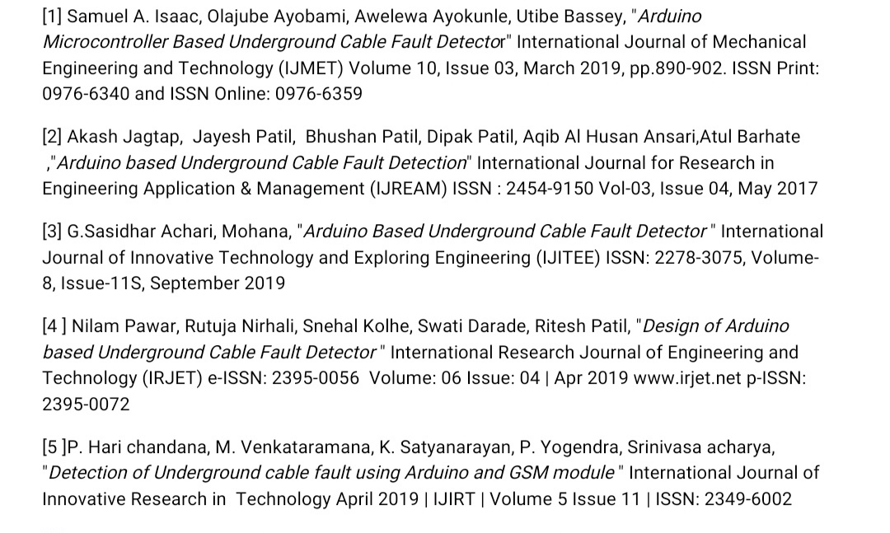
REFERENCES

Slide 17
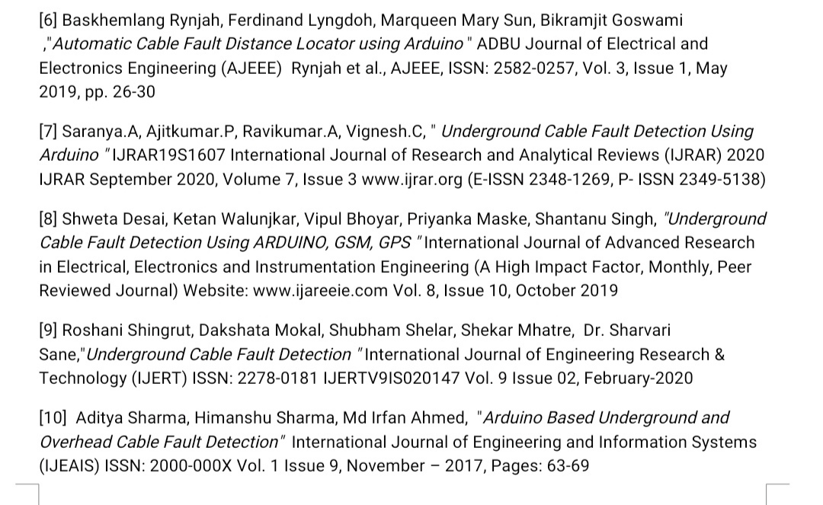

Slide 18


Slide 19
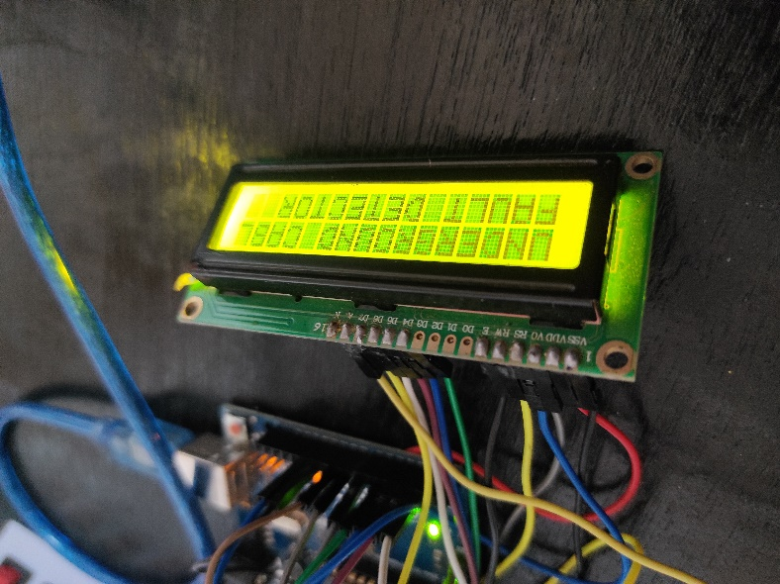
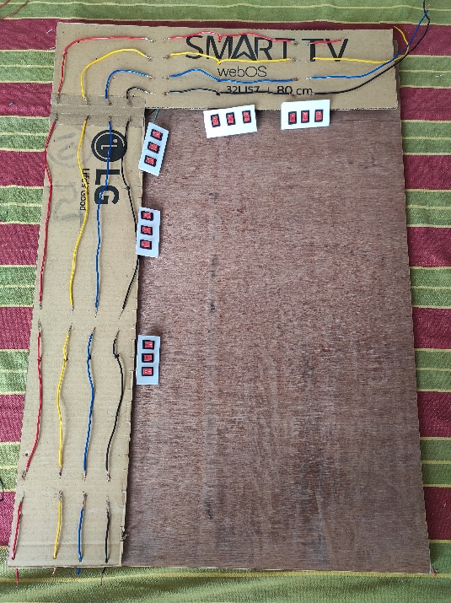
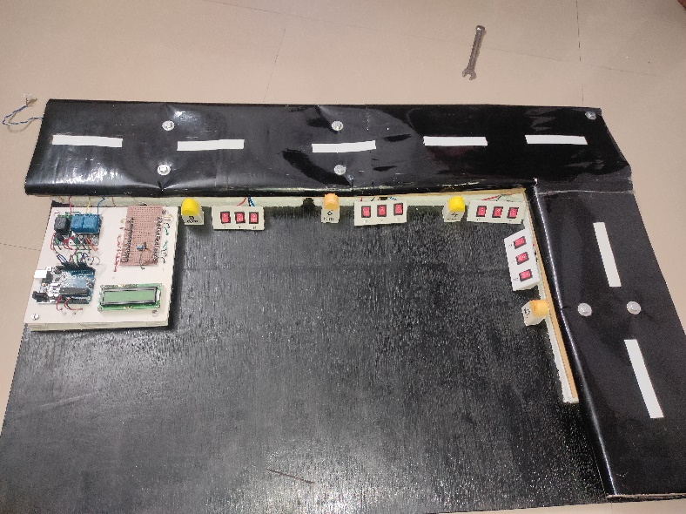
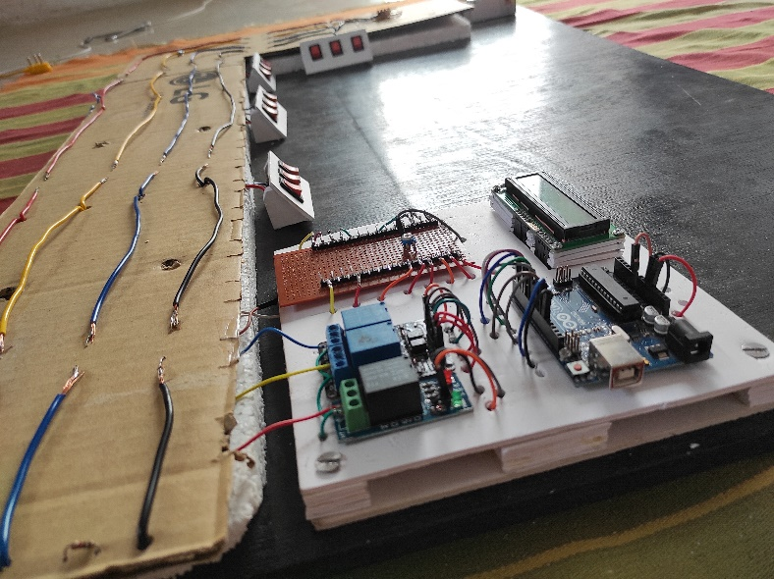
Thank You

